Slide 1
Microsoft Product Development Life Cycle, Systems & Tools
@ Vinayak Sharma

Slide 2
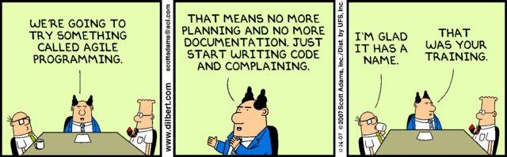
Traditional S/W Development & Agile
Notes:
How would you typically build apps at college?
Waterfall Model was followed traditionally. What are the disadvantages of Waterfall model?
Why is the process needed? Example: Traffic Signal

Slide 3
What is Agile?
Software evolves over time
Adaptive planning, evolutionary development, early delivery
Deliver value to the business sooner
Flexible response to change
Rapid
Adaptable
AGILE
Quality-driven
Cooperative
Iterative
Not a process, it's a philosophy or set of values

Slide 4
Product Vision
Scenario
Scenario
Scenario
Story
Story
Story
Story
Story
Story
Story
Story
Story
Task
Task
Task
Task
Task
Task
Task
Task
Task
Task
Task
Task
Task
Task
Task
Task
Task
Task
Task
Task
Task
Task
Task
Task
Task
Task
Task
Task
Task
Task
Task
Task
Task
Task
Task
Task
Task
Task

Slide 5
User Story – Why?
“…user stories help focus everyone’s energy on a tangible, customer-facing goal. They help avoid putting energy into extra code capabilities that are not actually adding value to a specific scenario. They also help ensure that when everyone thinks something is done the discussion stays around whether the customer-facing goal has been accomplished, rather than a bunch of people doing tasks that don’t add up to a coherent goal. ”

Slide 6
User Story – What’s involved?
Customer focus and value
Work that fits in a sprint
Relative estimation
Acceptance Criteria/done definition
FORMAT:
As a <user>, I want/need <some stuff> so that I can <value; why do I want/need it?>
User stories support scenarios!!!
Example:
As an Android phone user, I can quickly share a picture that was just taken so that my friends can see my vacation.

Slide 7
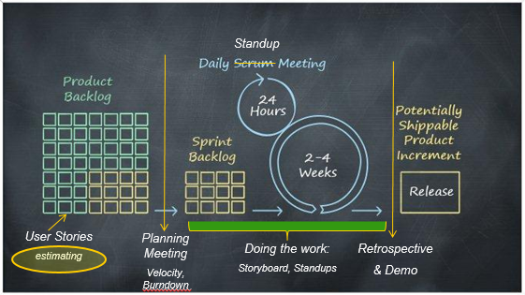
Agile S/W Development Lifecycle
Notes:
How is idea taken to implementation.
What is User Story?
Create Product Backlog with estimations.
Depending on team size and product scope sprint duration can be different.

Slide 8
Sprint Planning Meeting
Duration : Timeboxed to 8/4 hrs per week long Sprint
Broadly split in two parts
1st Part
Deals with ‘WHAT’ will be done in the Sprint.
Product Owner describes highest priority items
Any clarification questions by team members gets addressed
Team commits to as to how many user stories they can take for in the Sprint
2nd Part
Deals with ‘HOW’ team will handle work item it has taken on
Product Owner available to answer any questions
Team decides as to ‘Who’ take on what tasks

Slide 9
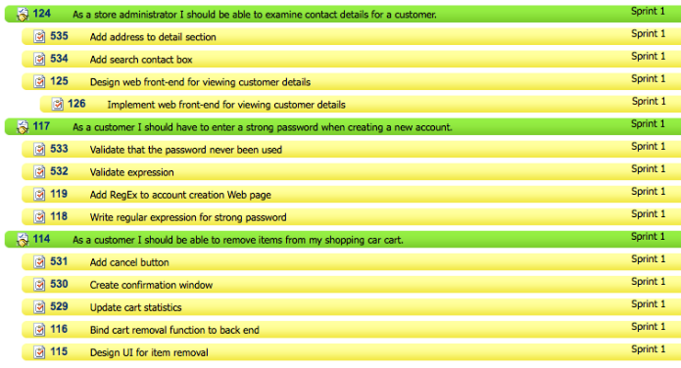
Sprint Planning Meeting - Outputs
List of User Stories the team commits to delivering
List of Tasks per User Story necessary to deliver on the committed user stories
Notes:
Talk about how dev and test will breakdown from user stories from tasks
The sprint backlog is the other output of sprint planning. A sprint backlog is a list of the product backlog items the team commits to delivering plus the list of tasks necessary to delivering those product backlog items. Each task on the sprint backlog is also usually estimated.
An important point to reiterate here is that it is the team that selects how much work they can do in the coming sprint. The product owner does not get to say, "We have four sprints left so you need to do one-fourth of everything I need." We can hope the team does that much (or more) but it is up to the team to determine how much they can do in the sprint.

Slide 10
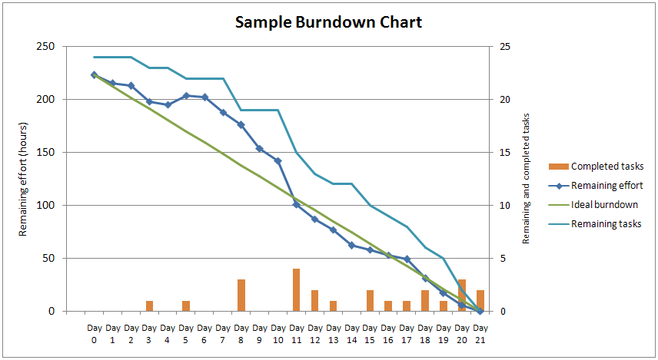
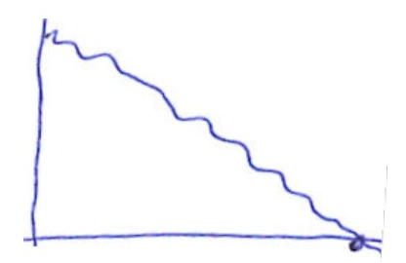
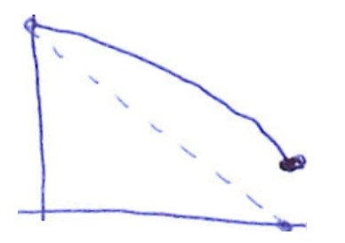
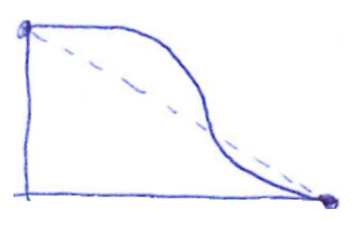
Burn Down Charts
Steady Progress Throughout
IDEAL TEAM
Almost no progress initially and then a big drop
Team Late for the Entire Sprint
Sprint Commitment Not Finished
GREAT TEAM !!
Some more work could have been completed
Time
Notes:
Easy to understand charts above.
Burn Down Charts are important to track the progress for large product development teams.

Slide 11
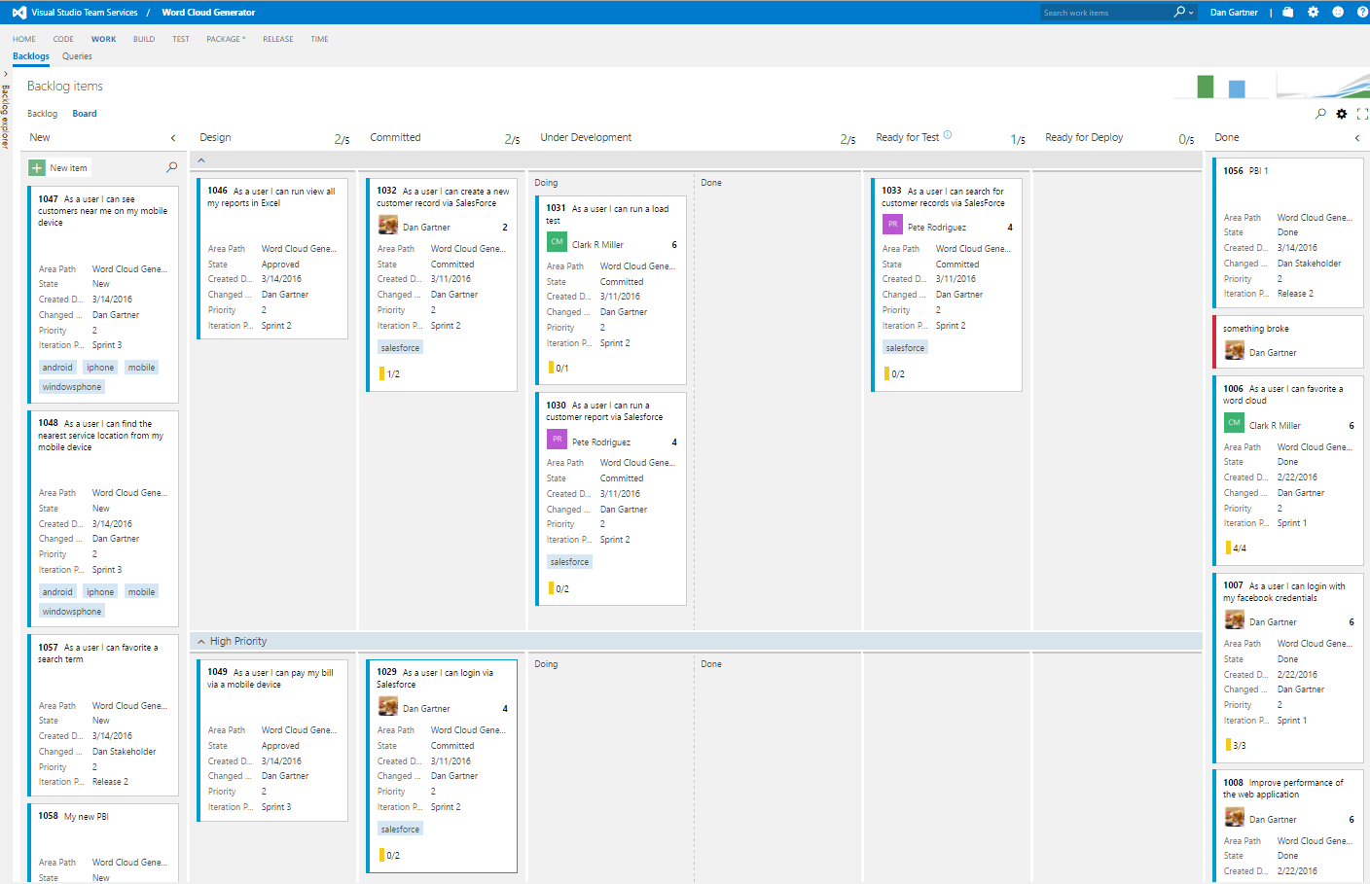
Kanban Board

Slide 12
Visual Studio Online / TFS
Time

Slide 13
Setting up team project on TFS
Create Project on TFS (Visual Studio Online)
Add Team Members
Create User Stories for the Product Idea
Add sub-stories & tasks.
Assign them to Team Members.
Notes:
Go to https://www.visualstudio.com/ and click on ‘Get Started for FREE’ for ‘Visual Studio Online’.
If possible try to do this exercise in group by forming teams and a product idea.

Slide 14
Setting up Visual Studio Project

Slide 15
Connecting TFS & Team Explorer on VS
Open Visual Studio.
Click on ‘Team Explorer’->Manage Connections.
Select the TFS & the project. Clone the repository.
Create a ‘New MVC Solution’ – Connected to Repository + Unit tests
Run Unit Tests. Make Changes etc.
Click on Changes. Write comment & Commit + Push.

Slide 16
Source Control (Git)
What is Source Control?
Why is Source Control Needed?
Diagram of Source Control Commands <Next Slide>
http://toolbox/Janus
Notes:
Commit more Push less

Slide 17
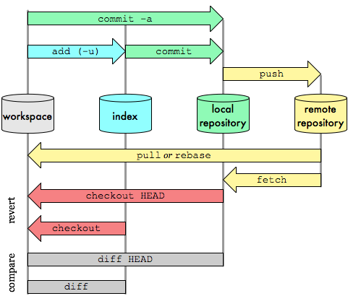
Git Transport Commands

Slide 18
Code Review, Checkin, Branching, Pull Request
Git & Source Depot Check-in Demo
Resolving Conflicts
Review Code with Pull Requests on Visual Studio
Review Code using CodeFlow (http://codeflow/)
Notes:
Create New Branch.
Pull everything.
Create a local branch.
Make change.
Commit to the new branch.
Create a Pull request. And add reviewers.
If merge conflicts, it will show up and you have to resolve them. Resolve in the local machine only.

Slide 19
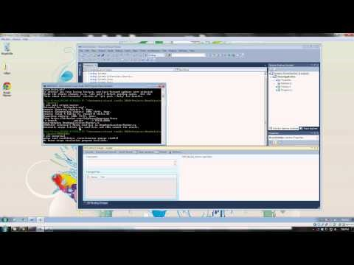

Slide 20
Source Control - Best Practices
Unless checked in, it does not exist
Commit Early. Commit Often
Inspect changes carefully before committing
Commit Messages… ‘It Works’, ‘Updated’, ‘Revision 1024’, ‘Axe Murderer’
Commit your changes. Don’t delegate
External Dependencies need to go in Source Control. Build Successfully

Slide 21
Writing Awesome Code!!

Slide 22

Implementation – Area under an arc
Write a function to compute area under the arc given the radius, and angle in degrees

Slide 23
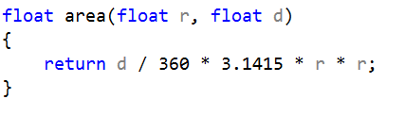
Implementation – First Iteration

Slide 24
Implementation – First Iteration
Issues with the above code?
r = radius or radians? –ve r?
d = diameter or degrees? –ve d? d > 360?
area of what?
What are the magic numbers?

Slide 25
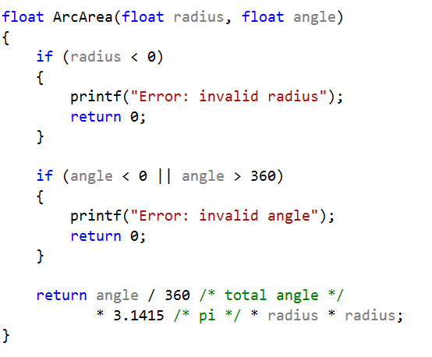
Implementation – Improvement

Slide 26
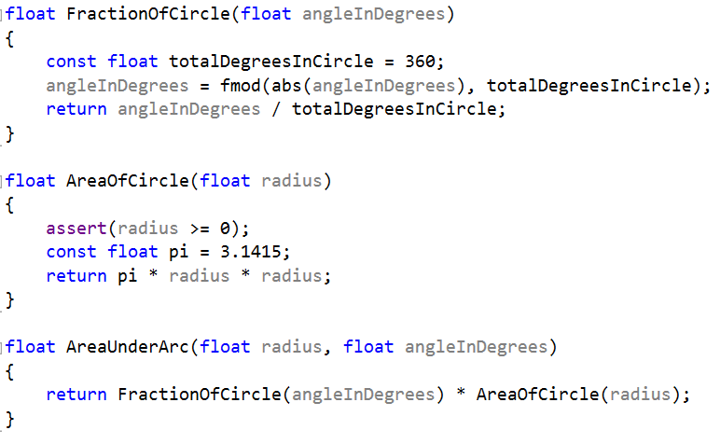
Implementation – Better Butter

Slide 27
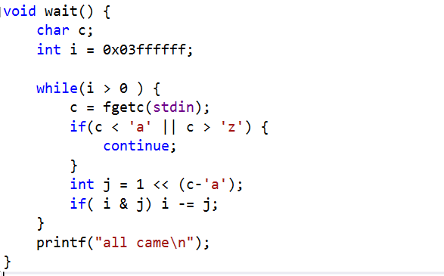
Implementation – Readable? ☺

Slide 28
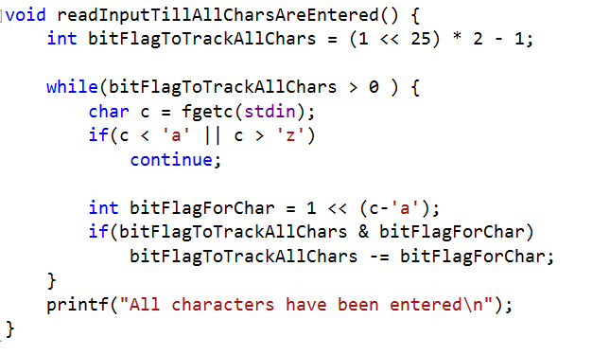
Implementation – Readable

Slide 29
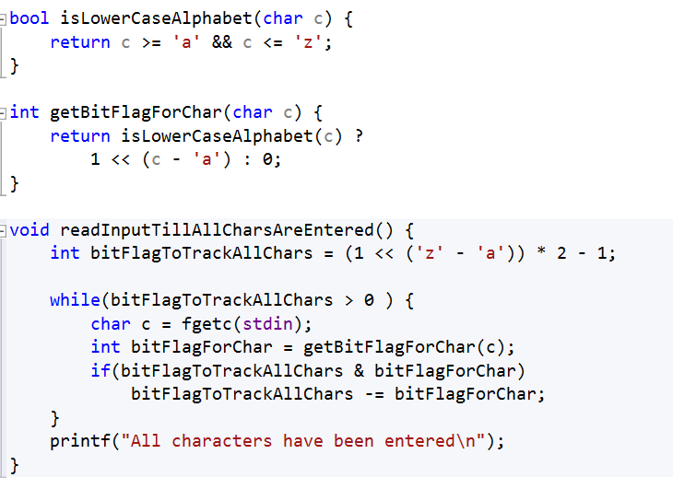
Implementation – Readable!

Slide 30
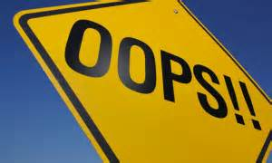
Validation & Error Handling
User Input
Validate
Error Message On Failure
Public
Visible outside module
Validate & throw exception
Internal
Visible outside class
Assert!
Defensive programming
Assert all assumption
Code as document!
Private
Not visible outside the class
Assert if not done already

Slide 31
Why & how to write Unit Tests?

Slide 32
Quality
What is Quality?
Importance & wearing tester hat
Planning at start for ensuring during and after execution
Notes:
Quality software is reasonably bug or defect free, delivered on time and within budget, meets requirements and/or expectations, and is maintainable.
ISO 8402-1986 standard defines quality as “the totality of features and characteristics of a product or service that bears its ability to satisfy stated or implied needs”
Quality is a perceptual, conditional and somewhat subjective attribute and may be understood differently by different people.
Reliability, Efficiency, Security, Maintainability,

Slide 33
Resources
TFS & Visual Studio : https://www.visualstudio.com/get-started/overview-of-get-started-tasks-vs
Source Control & Git : https://git-scm.com/book/en/v2/Getting-Started-About-Version-Control
CodeFlow for Code Review : http://codeflow/

Slide 34
To the brightest Good luck!! Enjoy your time at Microsoft ☺

Slide 35
Appendix

Slide 36
User Story Exercise – Let’s try one…
Scenario:
Stephanie was driving to work and got rear ended. Her car has over 100k miles on it and is in decent shape but it’s not worth getting fixed so she finds herself in the market for a new car and she’s very confused and nervous about making the right choice and not spending too much money. Stephanie decides to start looking and…
<magic happens>
Stephanie now has a great car with low miles and felt that she got a fair price. She’s relieved and is very happy with the car she chose.
Story Format:
As a <user>, I want/need <some stuff> so that I can <value; why do I want/need it?>

Slide 37
Example
As a 'Car Buyer', I can 'search for cars based on ratings' so that I can 'make the right choice'
As a 'Car Buyer', I can 'read reviews of new cars in the market' so that I can 'be better informed before buying the car'

